Slide 1



Create Safety, Connection & Belonging from the Very First Day
Hosted by: Alissa McGraw, Certified Instructor

Slide 2
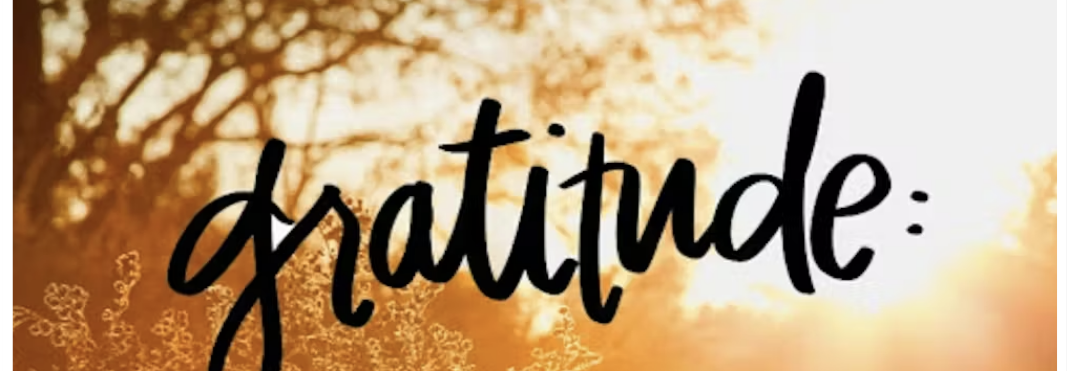


In the chat, write down the name of a teacher or principal that had a calming influence when you were in school. If you didn’t have one, write down anyone in your life who had this influence (aunt, friend,etc).

Slide 3
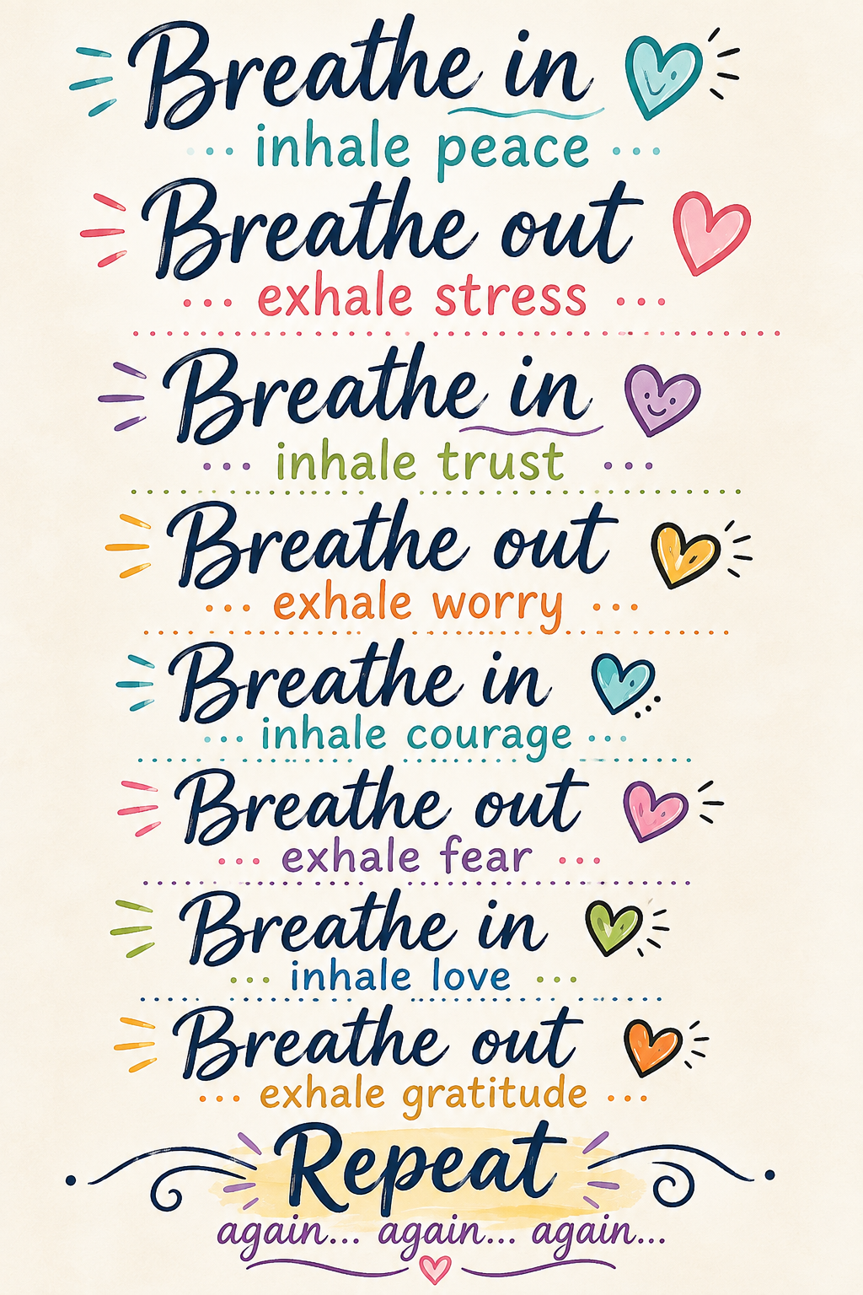
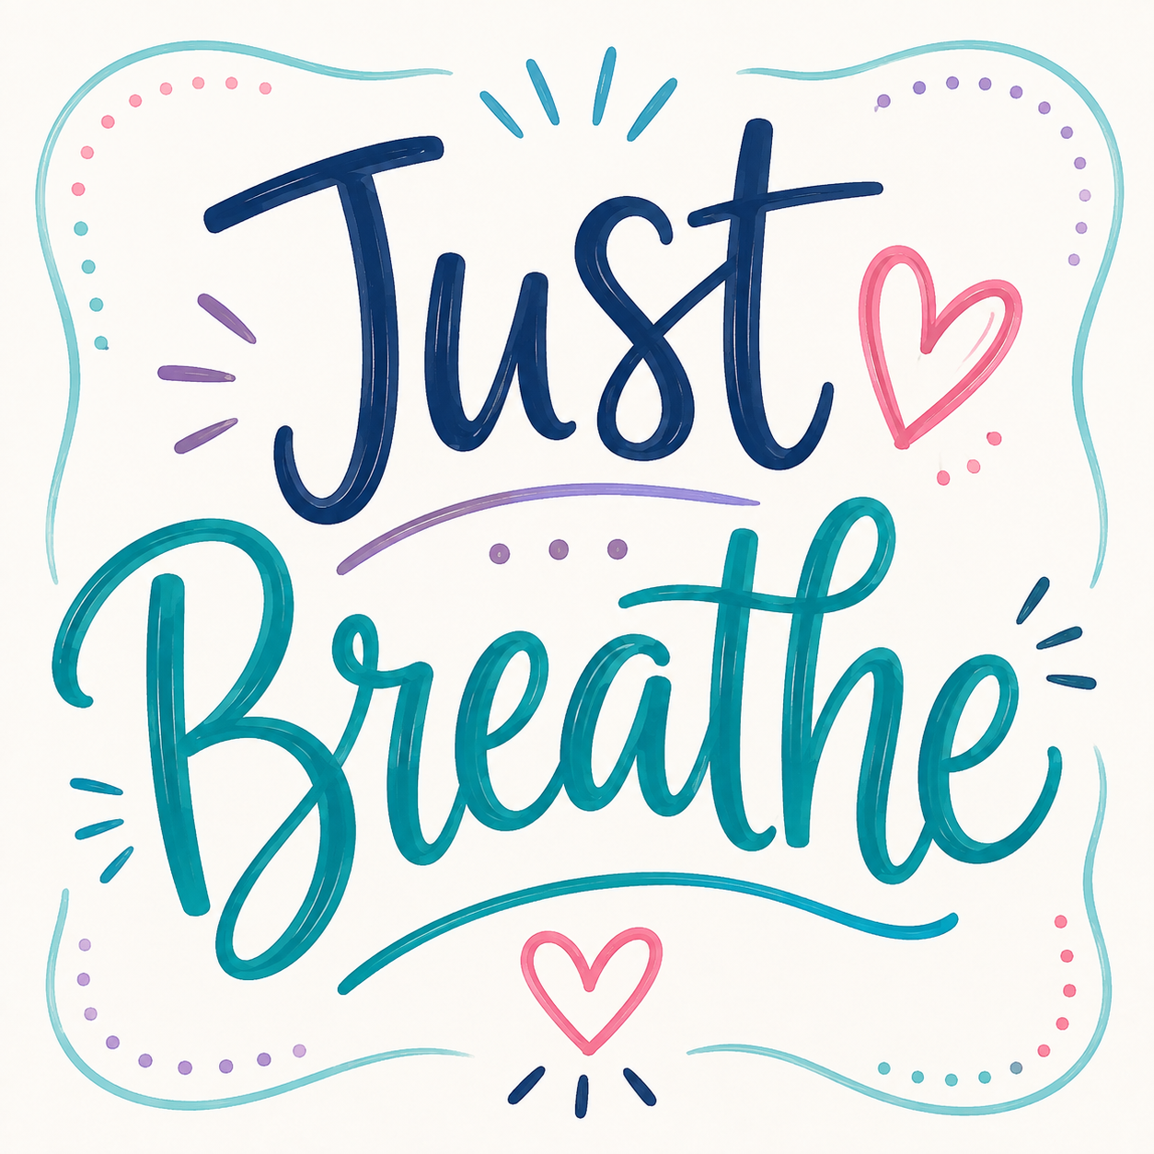

Slide 4
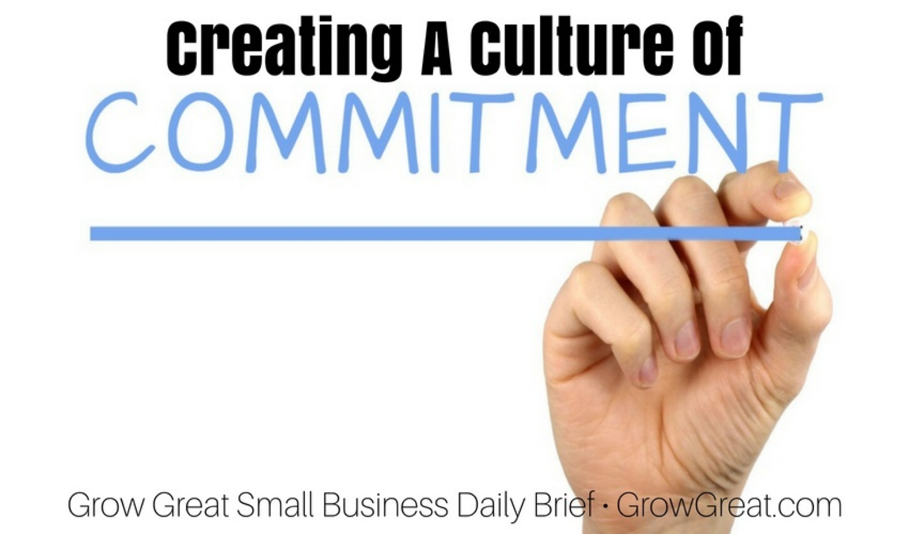

I am willing to pause and take a breath and listen to my thoughts. When I hear something new and different, I will work to be curious instead of judgmental.

Slide 5
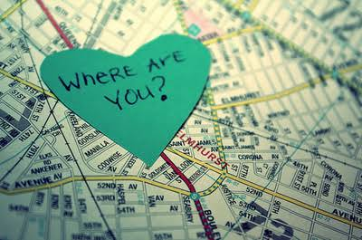
In the chat, tell me where you are at in your Conscious Discipline journey.
1- I am brand new and excited to learn!
2- I am a little familiar with it and have done a workshop/training but not sure where to begin/what to do next.
3- I/my organization implements it in classrooms/buildings and I’m wanting some reminders.

Slide 6

Our Time Together
Build a School Family from Day One
Use Routines and Rituals to Build Regulation
Create Relationships That Support Learning All Year

Slide 7

Build a School Family from Day One
Safety Comes Before Learning: Understanding how a child’s felt sense of safety impacts their ability to connect, participate, and learn
Connection is Intentionally Built: Use greetings, rituals, classroom jobs, and opportunities for contribution to help every child experience belonging
Create a Culture of “We”: Shift from managing a group of individual children to intentionally building a School Family where everyone is valued and responsible for one another

Slide 8
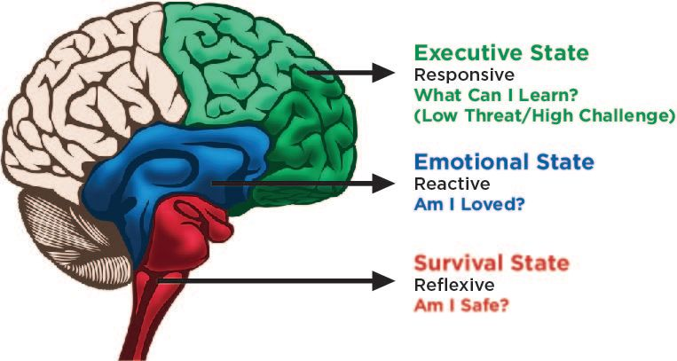
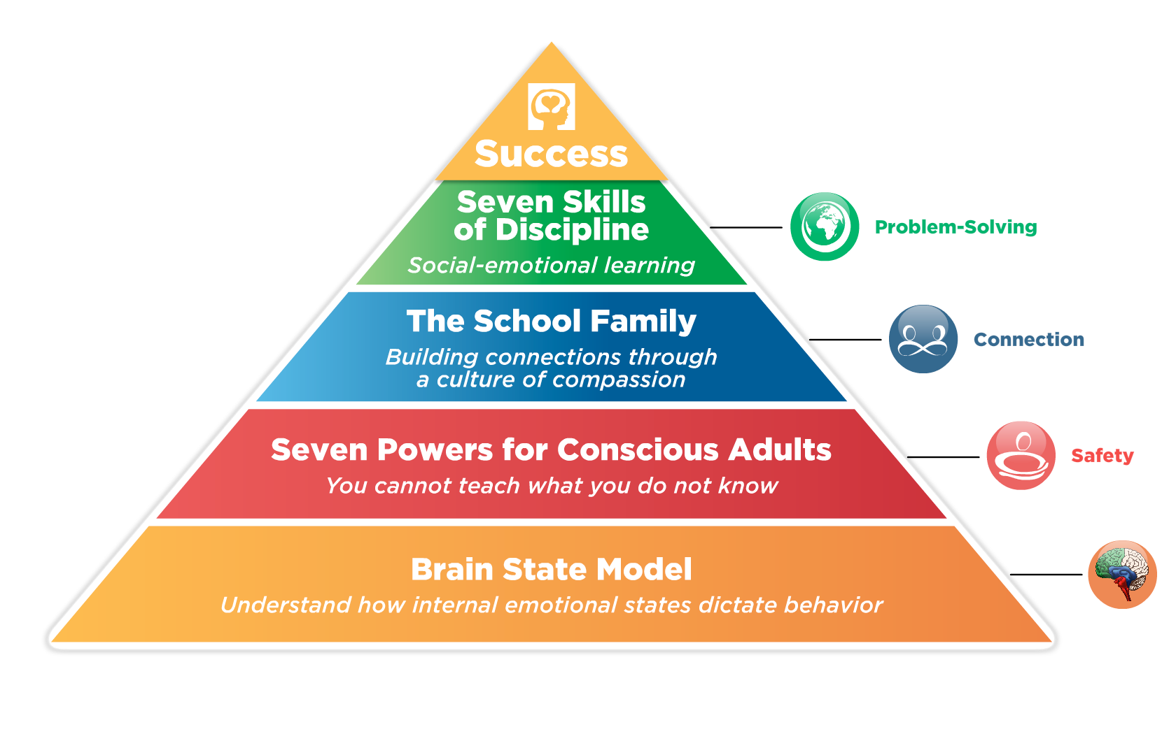
Safety Comes Before Learning
Without felt safety, a child may withdraw, avoid interaction, become overly dependent on an adult, or use challenging behavior to protect themselves or gain connection

Slide 9
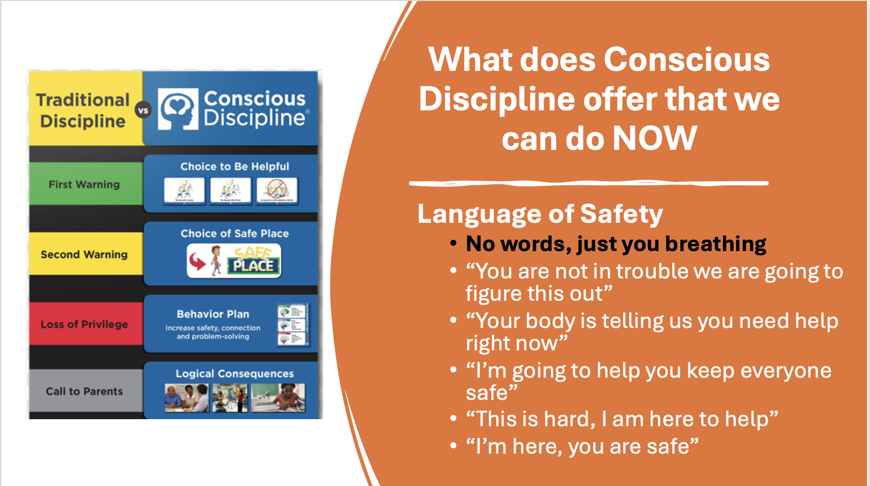

Slide 10
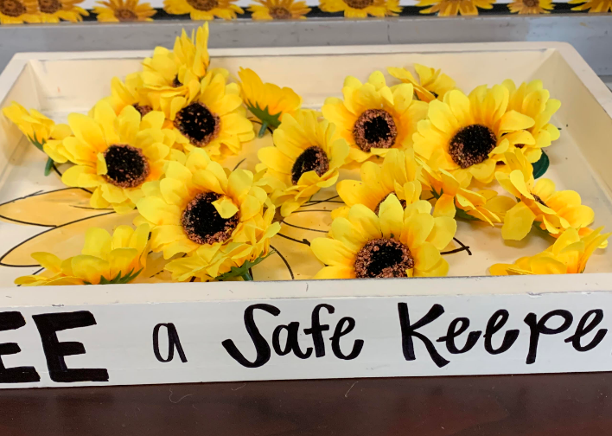
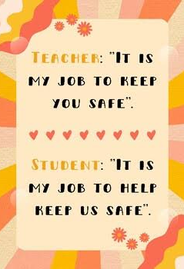
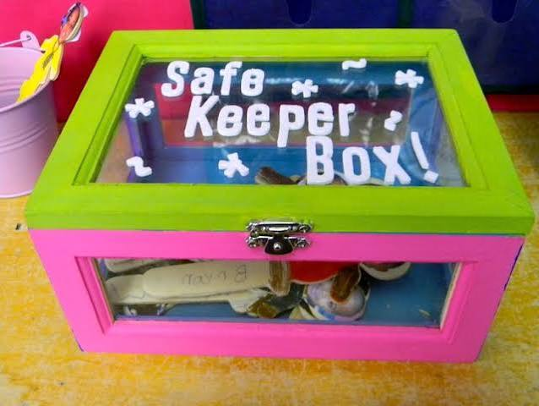
Safekeeper Job Description

Slide 11
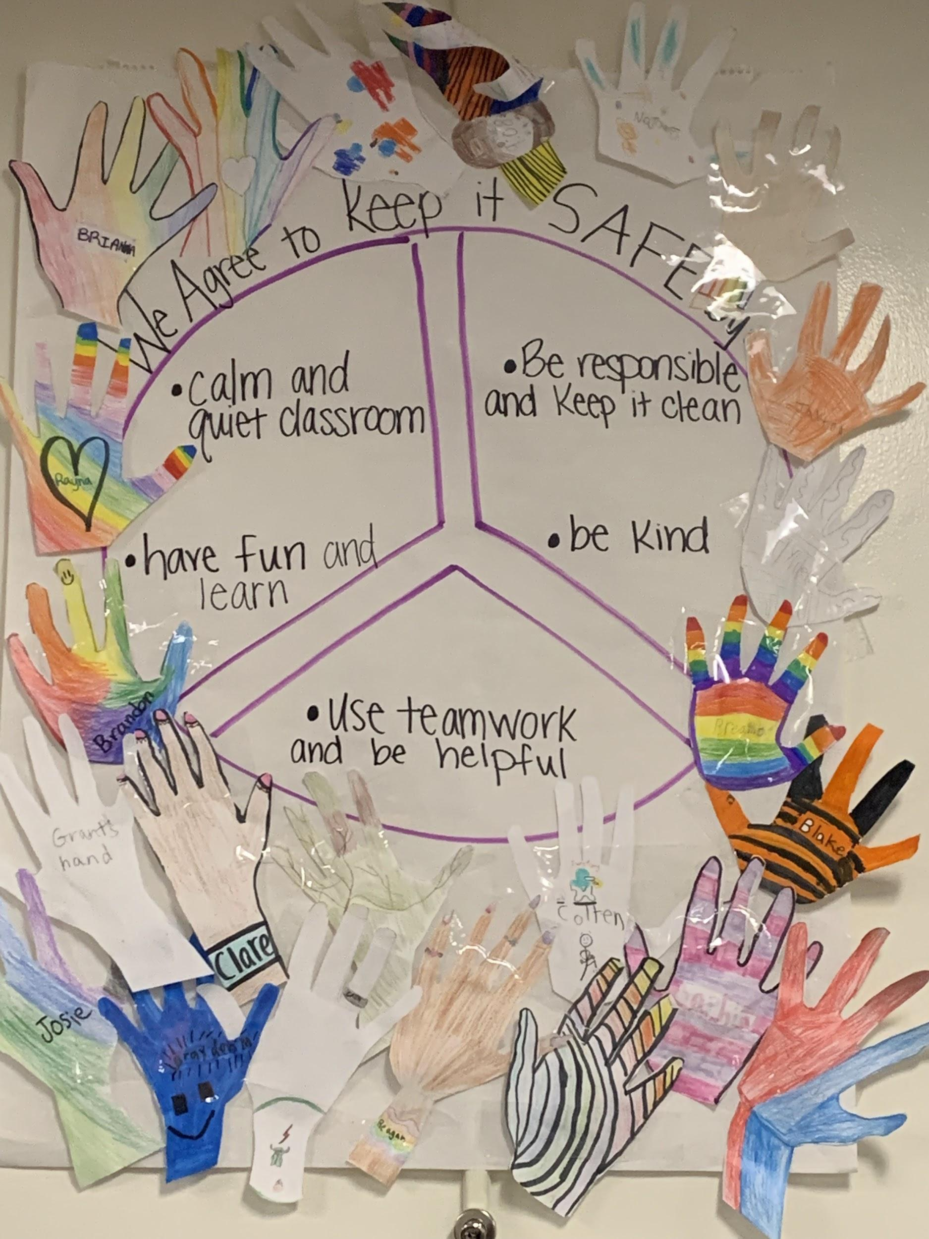
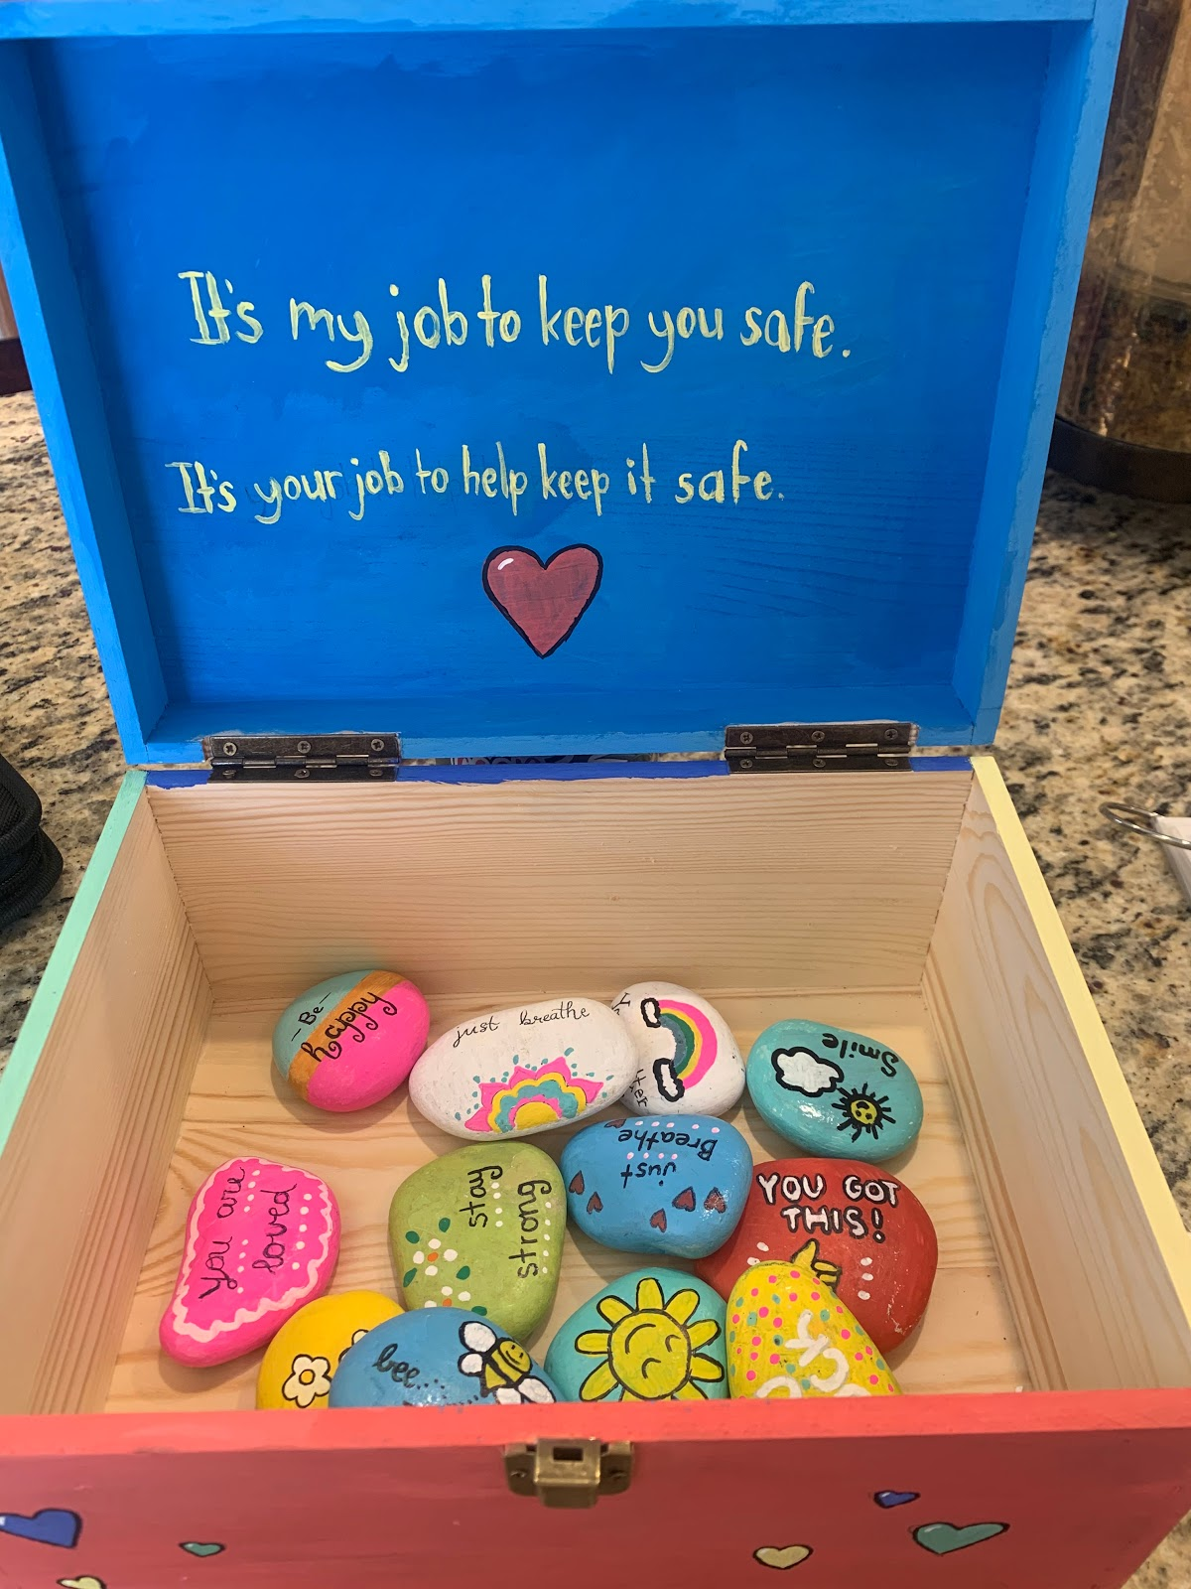

Slide 12
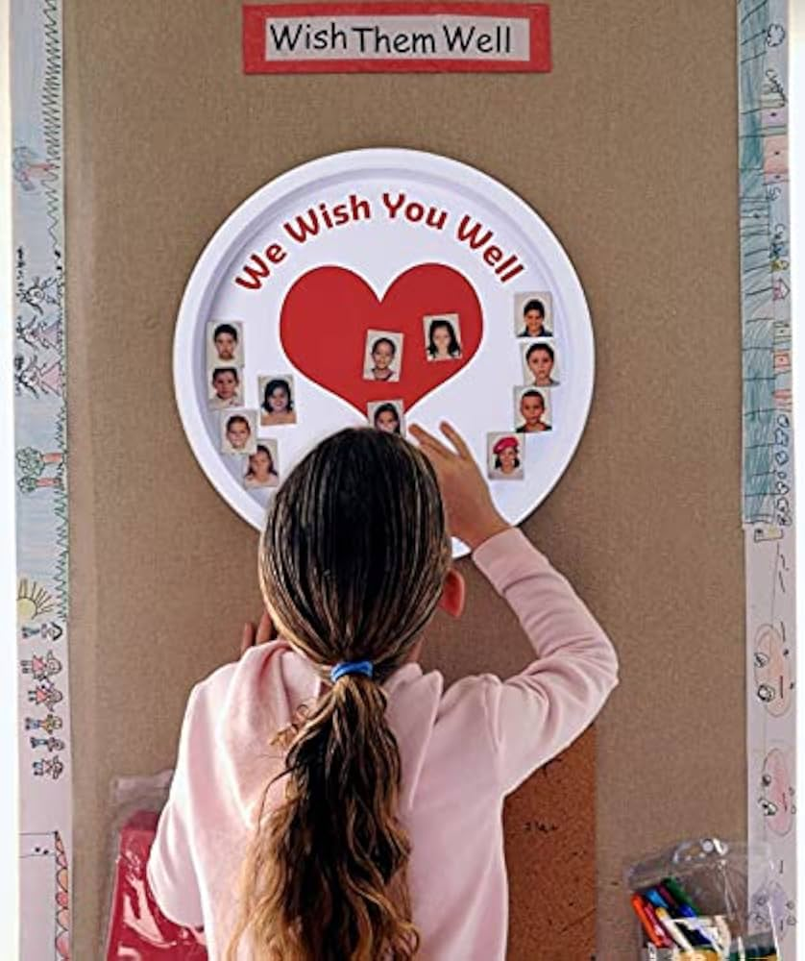

Connection is Intentionally Built
JOB EXAMPLES
• Kindness Recorder
• S.T.A.R. Person
• We Care Friend
• Wish Well Leader
• Encourager
• Welcome Back Helper

Slide 13
Create a Culture of “We”
Example: Morning Arrival
Managing a group of individual children might sound like: | Building a School Family might sound like:
“Put your backpack away. Sit on the carpet. Stop talking. We’re waiting for everyone. You need to listen.” | “Good morning, School Family! Let’s take care of our classroom together. When we arrive, we each have an important job. We put our things away, greet our friends, and get our bodies ready to learn. Look around—who can you help feel welcome this morning?”

Slide 14
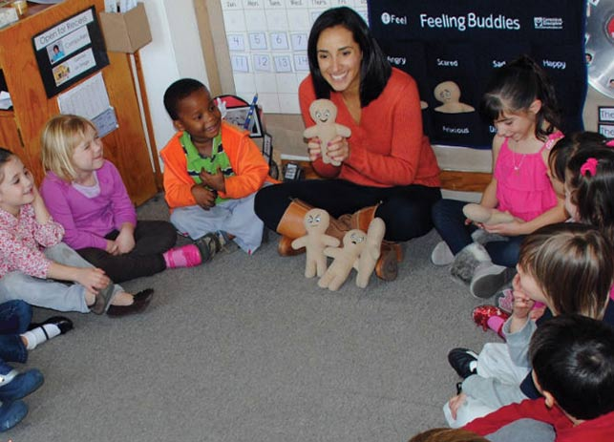
Use Routines and Rituals to Build Regulation
Predictability Creates Safety: Establish consistent routines that help children know what to expect and reduce uncertainty and stress
Teach, Don’t Just Tell: Use brain-based strategies to explicitly teach children how to regulate emotions, transition, and respond to challenges
Regulation Starts with the Adult: Recognize that the educator’s state of regulation influences the classroom and learn strategies for becoming a calm, connected presence

Slide 15
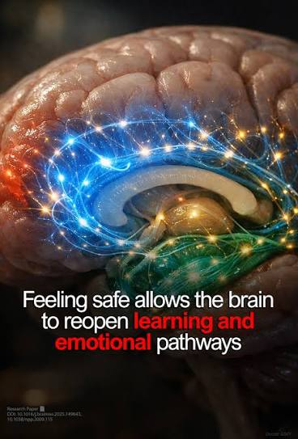
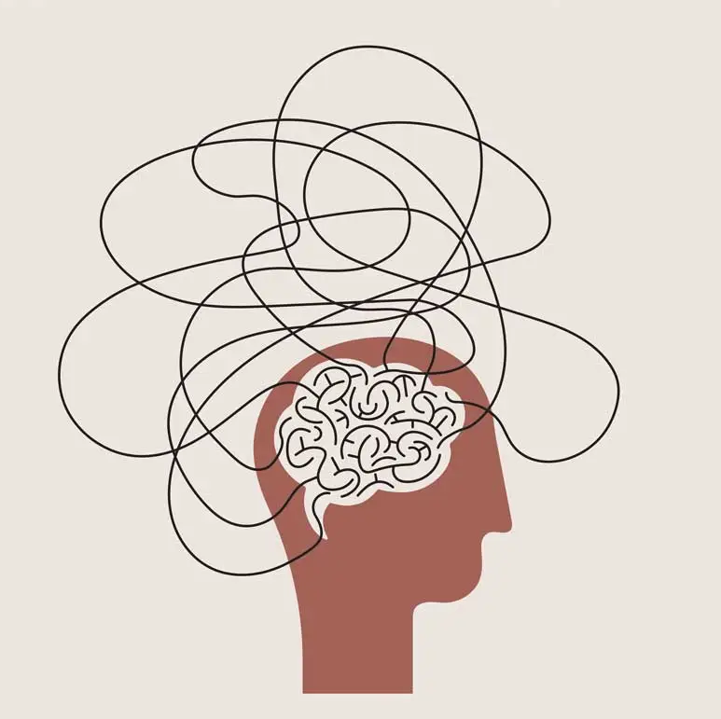
Use Routines and Rituals to Build Regulation
Routines don’t just organize the day—they organize the brain. When children know what to expect and experience connection within the routine, they can spend less energy figuring out if they are safe and more energy engaging in the learning
Examples: Brain Smart Start
Morning Greeting, Wish Well, Goodbye Ritual

Slide 16
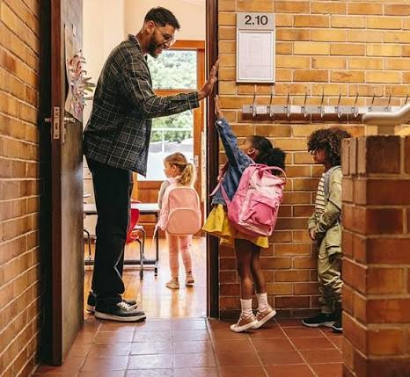
Greetings/Goodbye Ritual
The goal is real connection:
eye contact, touch, and presence in a playful situation. This ritual gives us the opportunity to assess a child’s inner state and upshift if necessary.

Slide 17
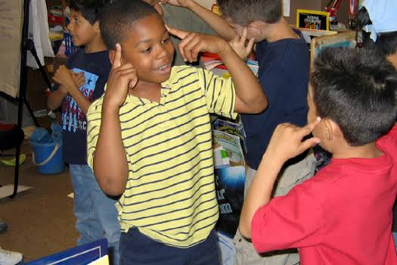
Brain Smart Start
Unite- brings scattered minds and bodies into a more congruent whole. Everyone on the same page, moving in unison.
Disengage Stress- stressed brains are unable to learn.
Connect- cooperation follows connection. Disconnected students are disruptive.
Commit-primes the brain for success and actively engages the prefrontal lobes. Builds self worth and releases feel good chemicals that help us focus our attention.

Slide 18
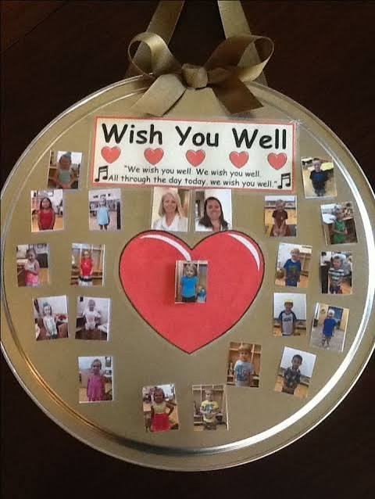
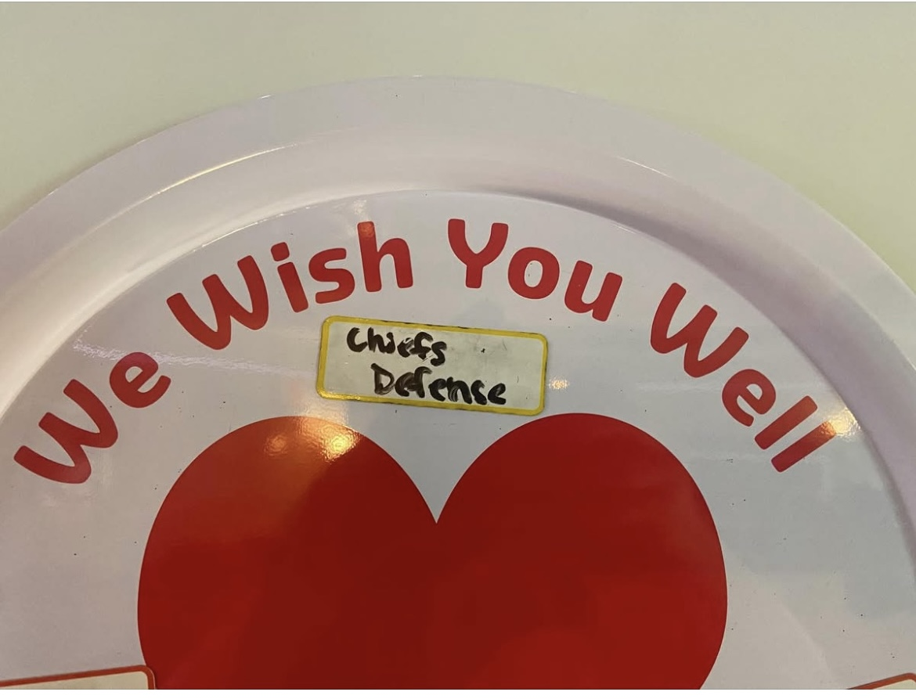
Wish Well
Asks children to wish others well that are absent or struggling with life’s challenges.

Slide 19
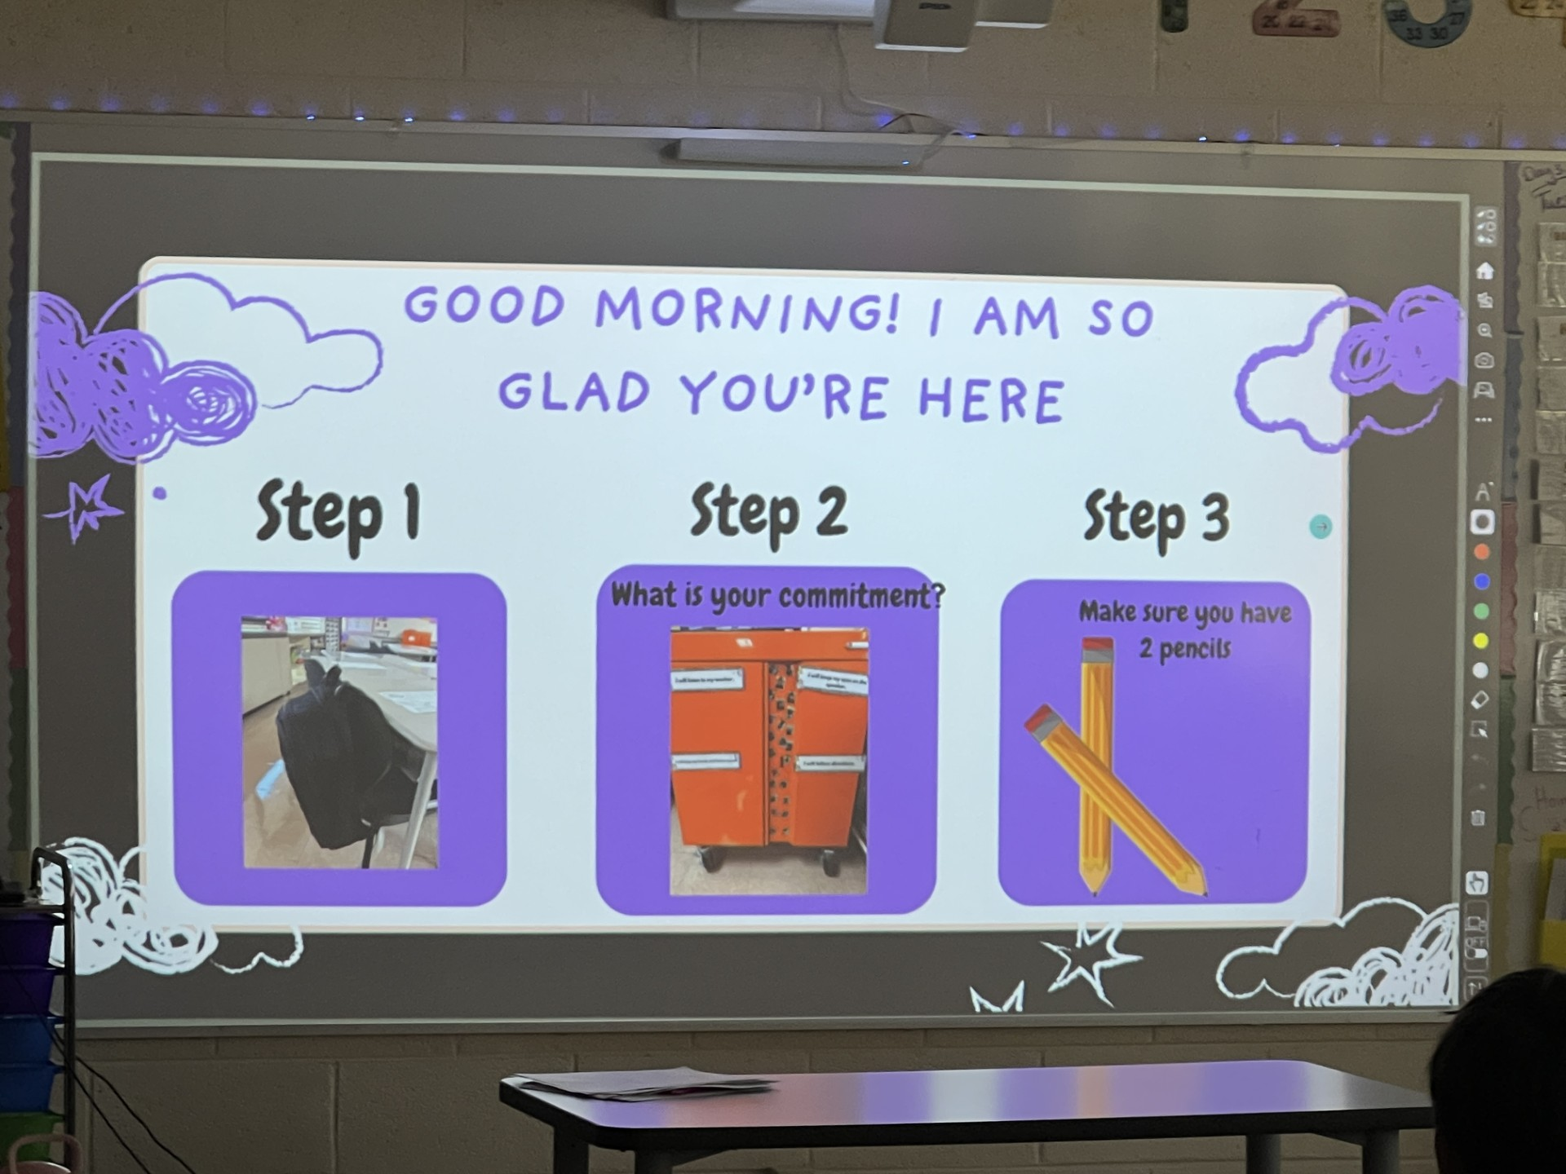
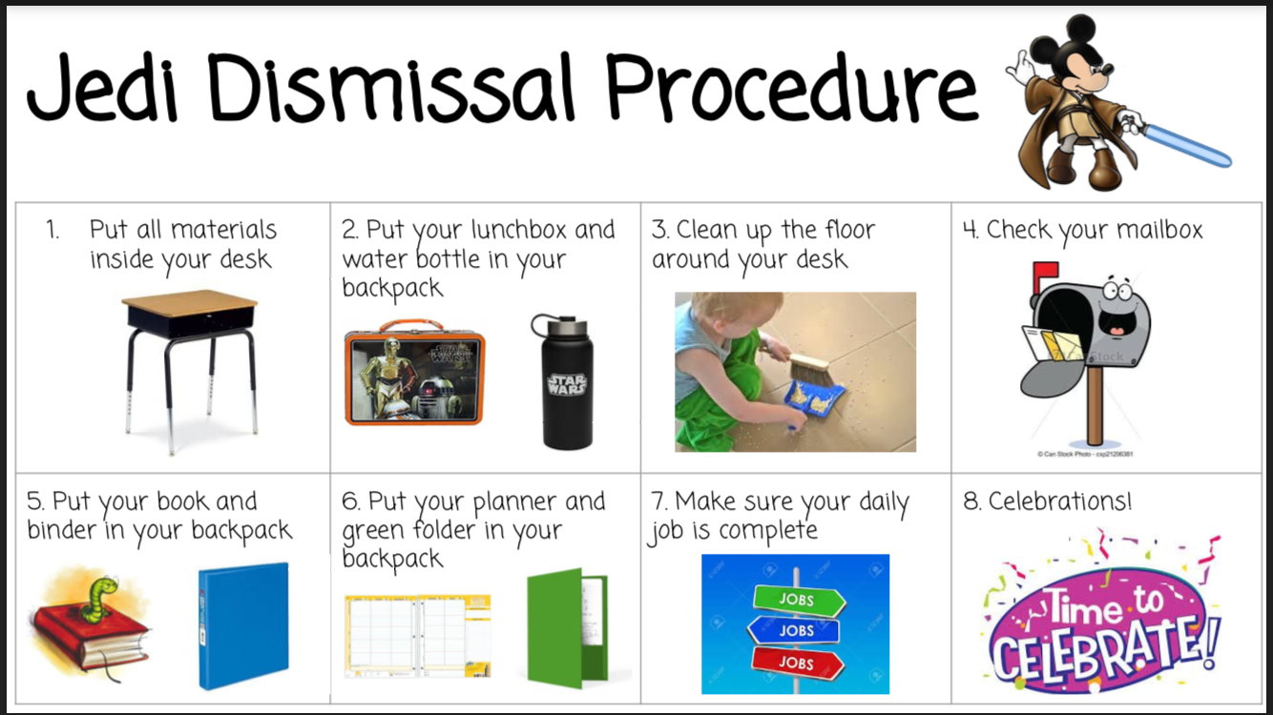
Visual Routines
Visual routines communicate our expectations to children through images. They are the ultimate form of assertive language. Routines add predictability and consistency to the classroom which in return creates safety.

Slide 20
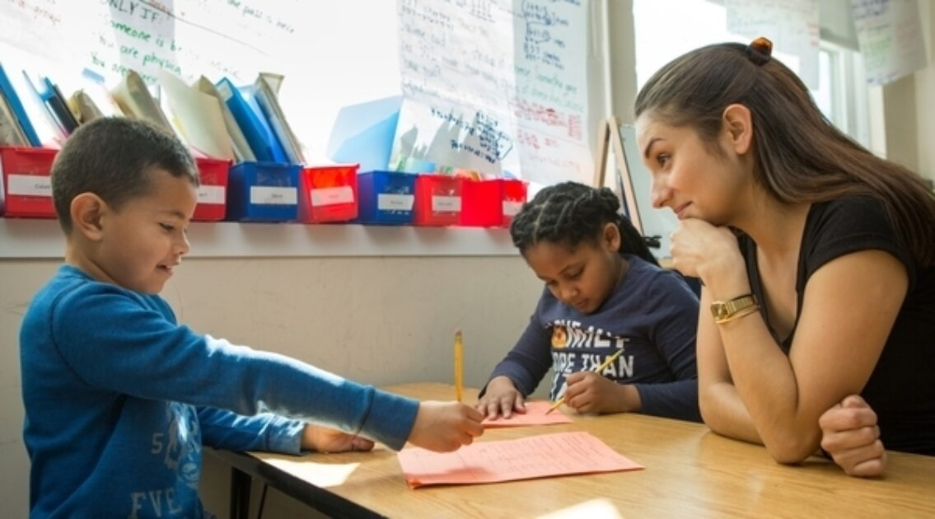
The Adult State Sets the Climate
The emotional tone of a classroom or organization begins with the adult. When leaders and educators regulate themselves first, they create the conditions where risk-taking, creativity, and possibility can flourish.

Slide 21

Regulation Fuels Curiosity
Curiosity is not a personality trait — it is a regulated state. When children and adults feel safe in their nervous systems, their brains are free to explore, create, and problem-solve. Safety is the prerequisite for wonder.

Slide 22
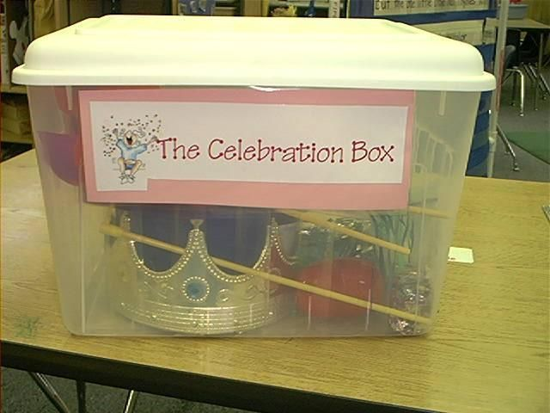
Create Relationships That Support Learning All Year
Connection is the Foundation for Cooperation: Build relationships that help children be more willing and able to participate, collaborate, and follow classroom expectations
See the Need Beneath the Behavior: Use challenging behaviors as opportunities to connect, teach and develop skills rather than simply correct behavior
Make Connection Part of the Daily Experience: Embed moments of empathy, encouragement, celebration and contribution throughout the day so relationships remain strong beyond the first weeks of school

Slide 23

Big Feelings Are Skill-Building Moments
Emotional outbursts are not interruptions to learning---- they are the learning.
When children become upset, it signals a missing regulation or problem-solving skill.
These moments provide the perfect opportunity to teach emotional awareness, impulse control, and communication

Slide 24
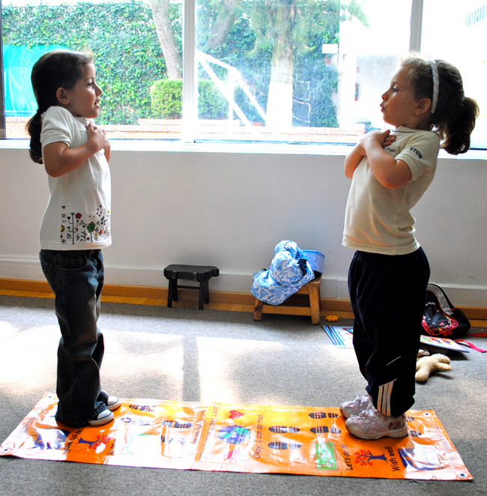
Instead of trying to STOP big feelings…………. TEACH children what to do with them
When adults stay calm, connect, and coach, we turn emotional storms into lifelong skills.

Slide 25

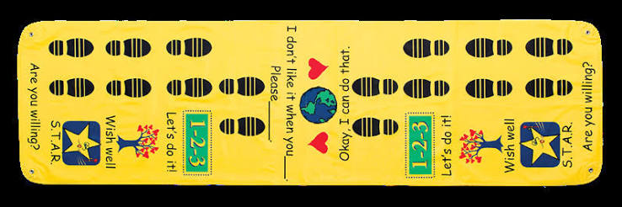
Time Machine Conflict Resolution Mat

Slide 26
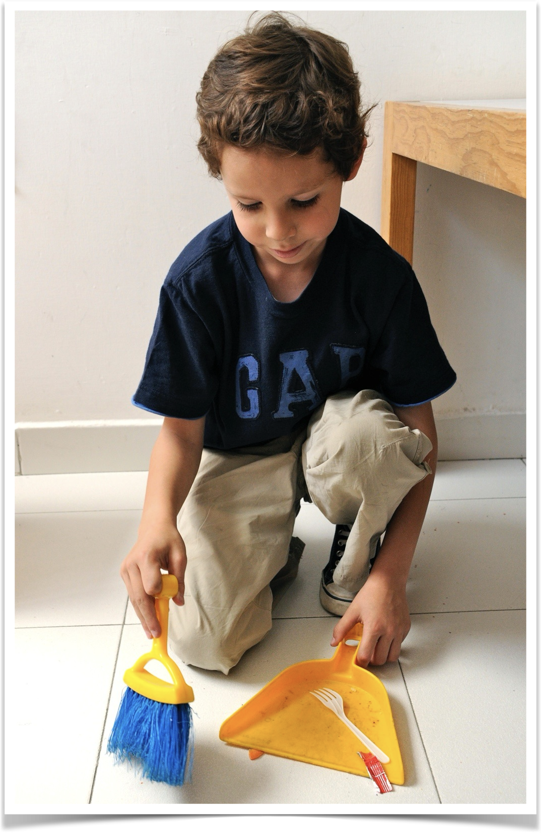
Noticing to Encourage kindness and helpfulness:
You ______ so that ______.
That was _________.
NOTICING:
”Jacob, you took the broom and the dustpan and started to clean up so that our classroom would be clean and we could walk by safely. That was helpful!”

Slide 27
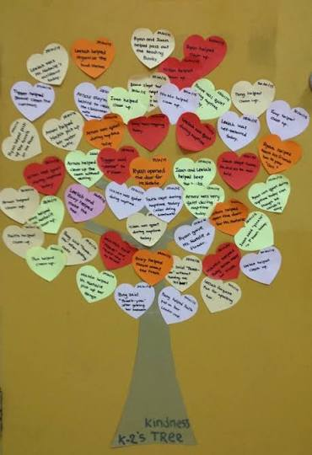
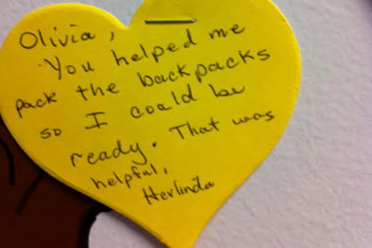
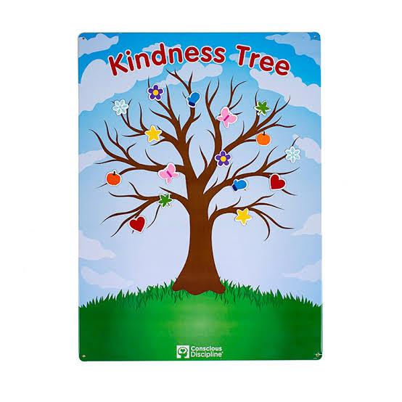
Kindness Ritual
Ritual that honors kind and helpful acts, helps adults and children shift from focusing on what is wrong to what is going well, and help highlight the many ways we serve one another. WHAT YOU FOCUS ON, YOU GET MORE OF!

Slide 28

Assertive Language
“HEY! Quiet down.”
PIVOT (turn, Breathe, turn back)
Walk to the group.
“It’s time to focus. If it’s too hard to do so as a group, feel free to find a quiet spot in the room to work on your own.”

Slide 29

Assertive Language
“It’s time to meet me on the carpet, ok?”
PIVOT (turn, Breathe, turn back)
With an assertive tone say:
“Stand up, push in your chair and walk to the carpet.”
“You did it! You came to the carpet and found your spot and sat down. Way to go!”

Slide 30

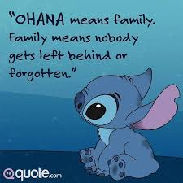
Make a list of what an ideal family would look like, sound like, and feel like.
Put a star or highlight the
Things you do in your classroom.

Slide 31
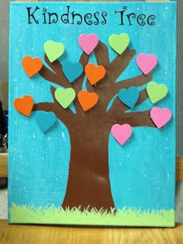
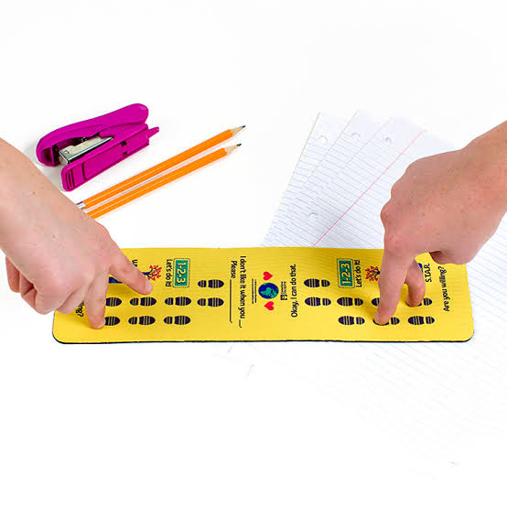
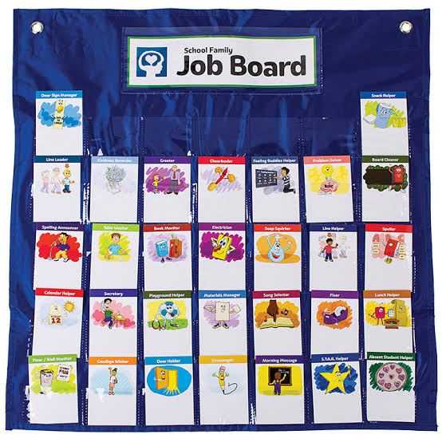
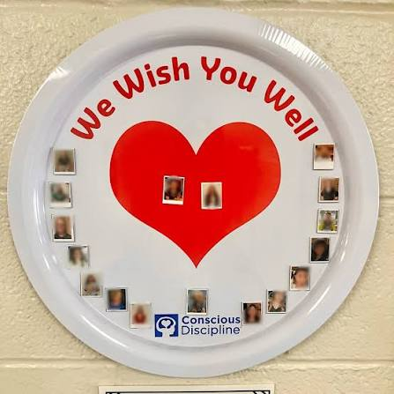
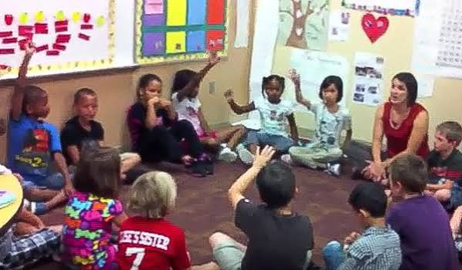
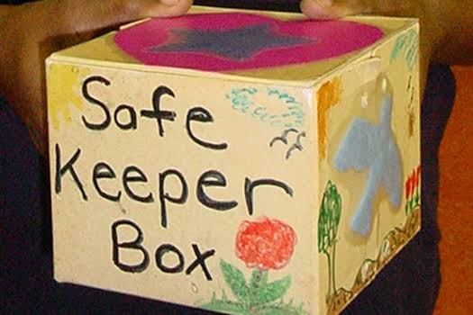
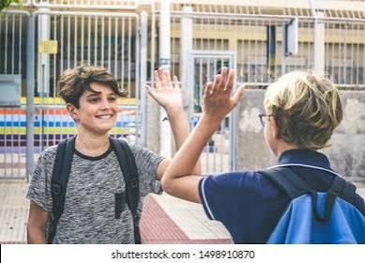
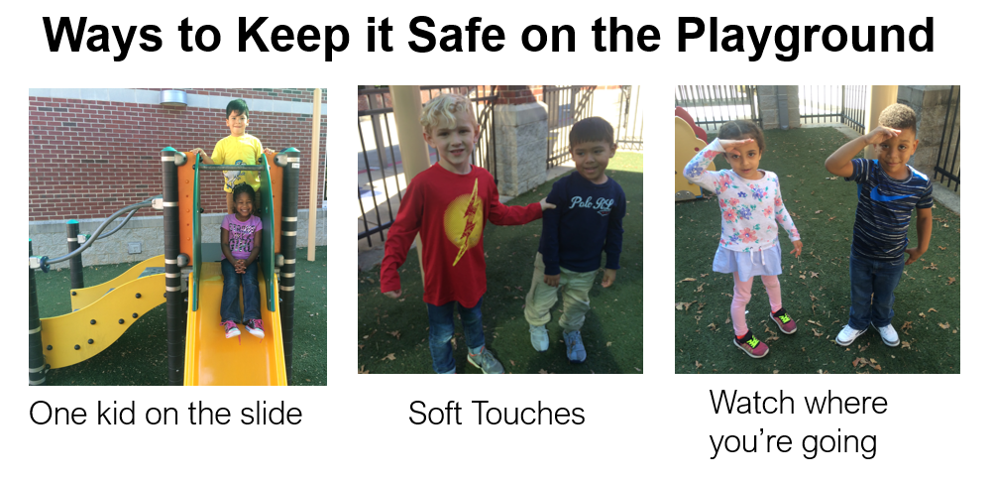
Next Steps?
  Greetings
  Safekeeper Job
  Brain Smart Start
  Wish Well
  Jobs for all students
  Kindness Tree/Notes
  Time Machine
  Visual Routines
  Safety language
  Assertive language

Slide 32
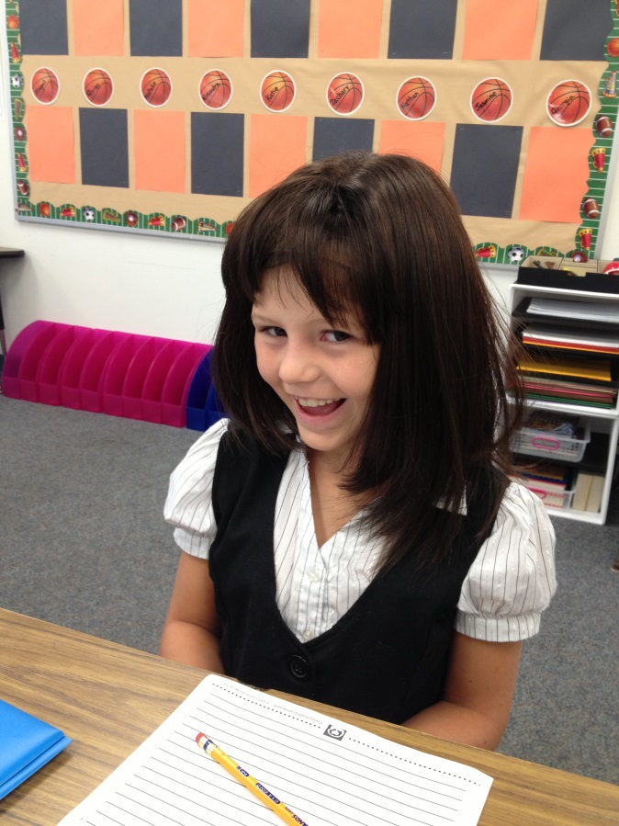
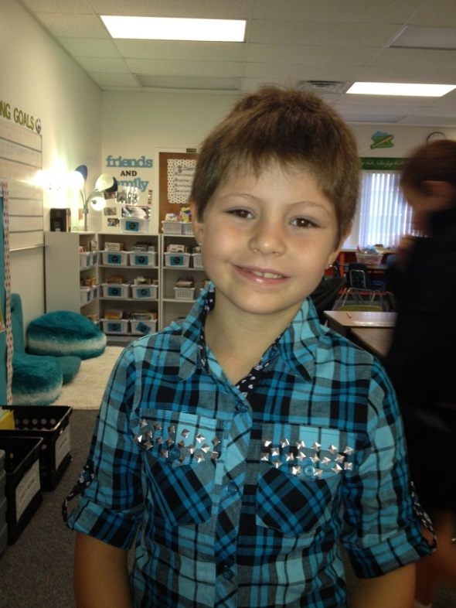
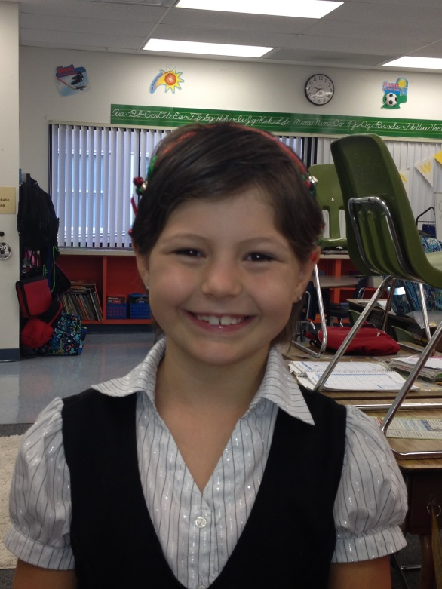
Look at what Conscious Discipline/School Family can do!

Slide 33
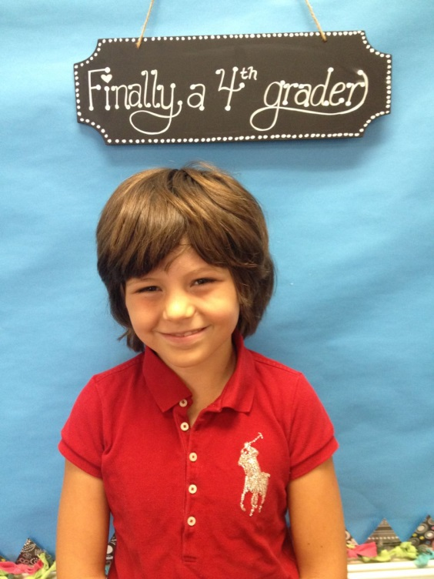
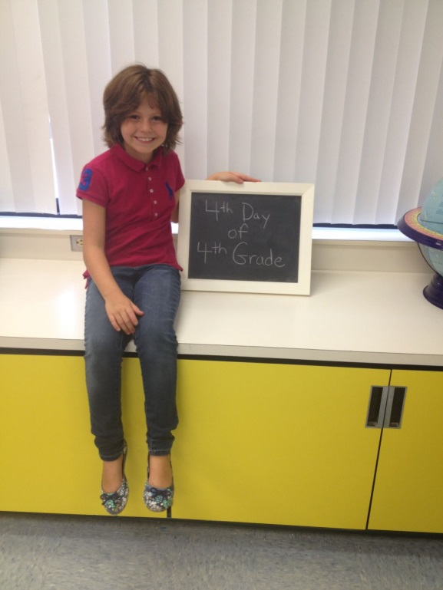
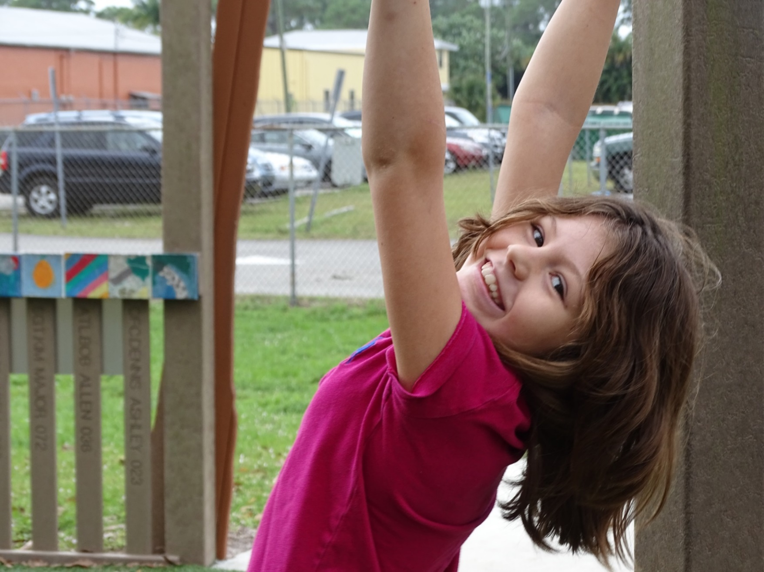
Look at what Conscious Discipline/School Family can do!

Slide 34
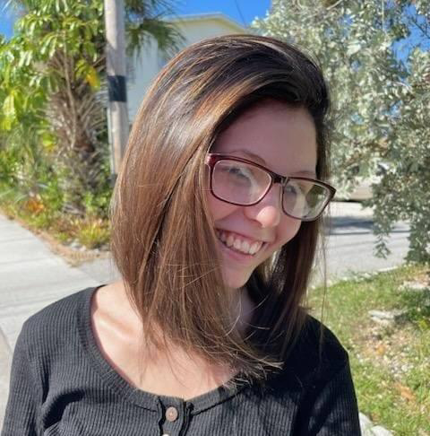
Look at what Conscious Discipline/School Family can do!
“Hi Mrs. McGraw. I don't know if you remember me my last name was staples I was in your class your last year teaching third and your first year teaching fourth grade at Palm City elementary and I just want to say thank you for being there for me in those 2 years it really meant a lot and I never forgot it and how much it meant to have someone like you in my life you really helped me and I am so thankful for that I hope your doing well and that your family is going well also. It was a teacher like you that really understood how to help a kid like me. In all honestly, I gave you most of the credit for helping my hair pulling.”

Slide 35
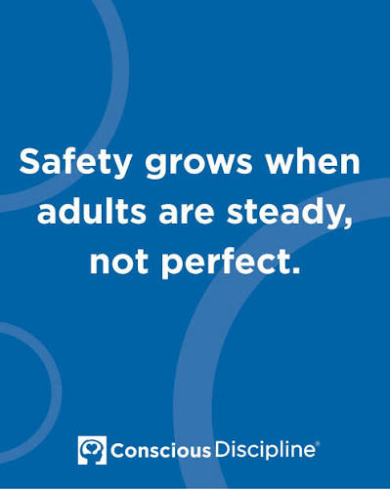
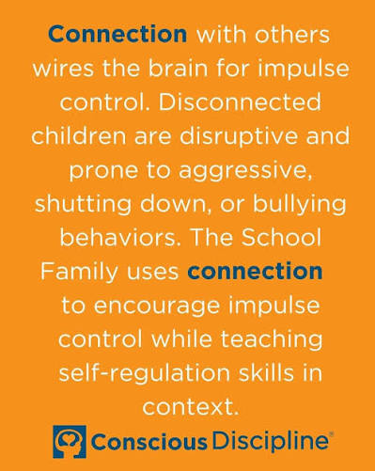
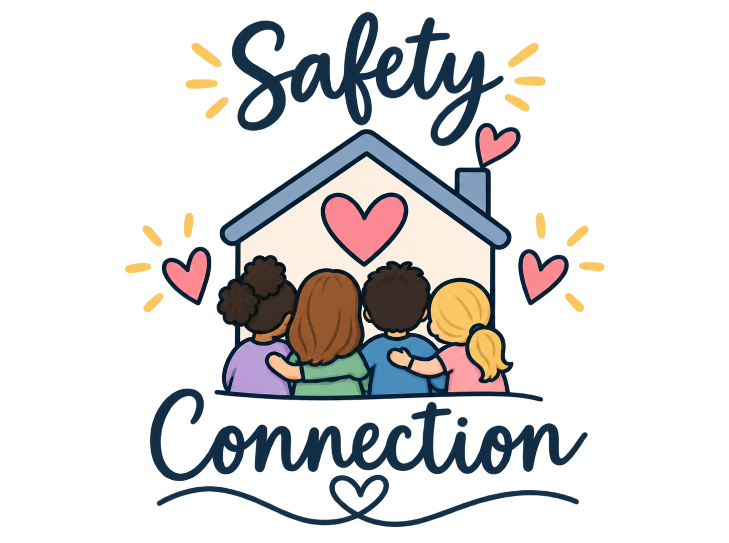

Slide 36


A Better Way: SAFE
Implementation Levels
The S.A.F.E. ecosystem is measured across four levels of implementation:
Core 1: Awareness- Understands concepts intellectually but has limited personal practice or modeling
Core 2- Acceptance- Begins to apply and values CD practice personally and professionally
Core 3- Application- Regularly applies CD Powers, Skills and Structures within systems and classrooms
Core 4- Integration- Practices are embedded, habitual, and community-wide

Slide 37


Conscious Discipline
Conscious Discipline empowers adults to create safe, connected, and self-regulated systems from classrooms to districts so children develop the emotional, behavioral, and executive skills they need to thrive.
Conscious Discipline is the only fully integrated adult-first framework that unites self-regulation, discipline, trauma-informed practice, and leadership development under one scalable system.

Slide 38

Become S.A.F.E.
Conscious Discipline helps your community become SAFE!
Talk to our Development Team about crafting a pathway of learning for your community that drives outcomes across leaders, teachers, families, and children:
Transformation@ConsciousDiscipline.com

Slide 39

How We Partner With You: The Conscious Discipline Methodology
We don’t just deliver training; we build capacity.
Discover &
Align
Phase 1: Build
Foundations
Phase 2: Classroom
Implementation
Phase 3: Deepen & Sustain
Format:
  Executive strategy sessions, data review, and school/ classroom walk-throughs
Outcomes:
  A clear, customized implementation pathway with milestones, roles, and measures of success
  Strong administrative buy-in and a shared vision that anchors all future phases
Format:
  Foundational workshops, intensive mindset training, and leadership development
Outcomes:
  A regulated, connected staff ready to model the social-emotional skills they will teach
  Common language and practices that unify how adults respond to behavior
Format:
  Design workshops, onsite and virtual coaching, in-class modeling, and classroom observations
Outcomes:
  Classrooms that function as cohesive, connected communities where children feel safe to learn
  Teachers equipped with practical tools, scripts, and rituals they can use every day
Format:
  Train-the-Trainer pathways, leadership development and certification, systems and process integration
Outcomes:
  A self-sustaining ecosystem of regulated adults and children, supported by internal experts
  Lasting improvements in school climate and adult practice that persist through leadership and staff transitions

Slide 40




Attend An Upcoming Event!
September 20-25
INSTITUTE
Conscious Discipline:
Birth to Five Years
Madison, WI
October 15–17
ANNUAL CONFERENCE
Elevate Conscious
Discipline:
S.A.F.E. Starts with Us
Orlando, FL
November 17–18
WORKSHOP
Safer Schools and
Stronger
Behavior Systems
Oklahoma City, OK
November 19–20
WORKSHOP
Conscious Discipline Coaching: A New Model
for Practice and
Mindset Shifts
Oklahoma City, OK

Slide 41

In the chat share one thing you will do differently or add to your first weeks of school

Slide 42


If you are willing, in the chat share with us someone who could use our well wishes today.

Slide 43


Slide 44


Slide 45

Your Next Step Starts With One Conversation
Alissa said it herself: 18 years ago she walked out of an institute thinking, this is amazing, but where in the world do I begin?
You don't have to answer that alone.
Book a call with a Conscious Discipline implementation advisor to talk through:
where your school or classroom is right now
what a realistic first phase looks like
how to build safety and connection that lasts past September.
Scan to book your call.

